Slide 1
Clustering Algorithm (DBSCAN)
SaiKiranmai

Slide 2
DBSCAN algorithm
(Density-based spatial clustering of applications with noise)

Slide 3
Outline
Introduction to Clustering
Density-based Clustering
Definitions of DBSCAN
DBSCAN Algorithm
Implementation in Python

Slide 4
What is Clustering?
Clustering is an unsupervised machine learning algorithm that divides a data into meaningful sub-groups, called clusters.
In general a grouping of objects such that the objects in a group (cluster) are similar (or related) to one another and different from (or unrelated to) the objects in other groups
Inter-cluster distances are maximized
Intra-cluster distances are minimized

Slide 5
Density-based Clustering Methods
Clustering based on density (local cluster criterion), such as density-connected points
Major features:
Discover clusters of arbitrary shape
Handle noise
Need density parameters as termination condition
Several interesting studies:
DBSCAN: Ester, et al. (KDD’96)
OPTICS: Ankerst, et al (SIGMOD’99).
DENCLUE: Hinneburg & D. Keim (KDD’98)
CLIQUE: Agrawal, et al. (SIGMOD’98) (more grid-based)

Slide 6
DBSCAN: (Density-based spatial clustering of applications with noise)
Proposed by Ester, Kriegel, Sander, and Xu (KDD96)
Basic Idea: Clusters are dense regions in the data space, separated by regions of lower object density
Discovers clusters of arbitrary shape in spatial databases with noise

Slide 7
Density Based Clustering: Basic Concept
Intuition for the formalization of the basic idea
For any point in a cluster, the local point density around that point has to exceed some threshold
The set of points from one cluster is spatially connected
Local point density at a point p defined by two parameters
ε : Maximum radius of the neighbourhood of point p.
MinPts : Minimum number of points in an ε -neighbourhood of that point.

Slide 8
ε-Neighborhood
ε-Neighborhood – Objects within a radius of ε from an object.
“High density” - ε-Neighborhood of an object contains at least MinPts of objects.
ε-Neighborhood of p
ε
ε
ε-Neighborhood of q
q
p
Density of p is “high” (MinPts = 4)
Density of q is “low” (MinPts = 3)

Slide 9
Core, Border & Outlier
Given ε and MinPts, categorize the objects into three exclusive groups.
Outlier
Border
A point is a core point if it has atleast specified number of points (MinPts) within Eps (including itself). These are points that are at the interior of a cluster.
A border point has fewer than MinPts within Eps, but is in the neighborhood of a core point.
A noise point is any point that is not a core point nor a border point.
Core
ε = 1unit, MinPts = 5

Slide 10
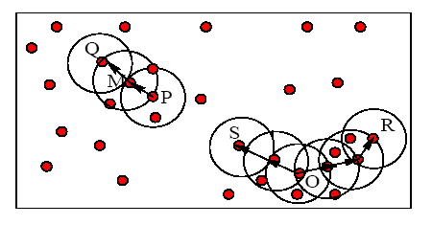
Example
M, P, O, and R are core objects since each is in an Eps neighborhood containing at least 3 points
Minpts = 3
Eps=radius of the circles

Slide 11
Directly Density-Reachable
An object q is directly density-reachable from object p if p is a core object and q is in p’s ε-neighborhood.
q is directly density-reachable from p
p is not directly density- reachable from q?
Density-reachability is asymmetric.
ε
ε
q
p
MinPts = 4

Slide 12
Density-Reachable
A point p is density-reachable from a point q w.r.t. Eps, MinPts if there is a chain of points p₁, …, p_{n}, p₁ = q, p_{n} = p such that p_{i+1} is directly density-reachable from p_{i}
A point p is directly density-reachable from p2;
p2 is directly density-reachable from p1;
p1 is directly density-reachable from q;
p←p2←p1←q form a chain.
p is (indirectly) density-reachable from q
q is not density- reachable from p?
p
p₂
p₁
q
MinPts = 7

Slide 13
Density-Connected
A point p is density-connected to a point q w.r.t. Eps, MinPts if there is a point o such that both, p and q are density-reachable from o w.r.t. Eps and MinPts
p
q
o

Slide 14
DBSCAN Algorithm
Input: The data set D
Parameter: ε, MinPts
For each object p in D
if p is a core object and not processed then
C = retrieve all objects density-reachable from p
mark all objects in C as processed
report C as a cluster
else mark p as outlier
end if
End For
DBScan Algorithm

Slide 15
DBSCAN: The Algorithm
Arbitrary select a point p
Retrieve all points density-reachable from p wrt Eps and MinPts.
If p is a core point, a cluster is formed.
If p is a border point, no points are density-reachable from p and DBSCAN visits the next point of the database.
Continue the process until all of the points have been processed.

Slide 16
DBSCAN Algorithm: Example
Parameter
ε = 2 cm
MinPts = 3
for each o ∈ D do if o is not yet classified then if o is a core-object then collect all objects density-reachable from o and assign them to a new cluster. else assign o to NOISE

Slide 17
DBSCAN Algorithm: Example
Parameter
ε = 2 cm
MinPts = 3
for each o ∈ D do if o is not yet classified then if o is a core-object then collect all objects density-reachable from o and assign them to a new cluster. else assign o to NOISE

Slide 18
DBSCAN Algorithm: Example
Parameter
ε = 2 cm
MinPts = 3
for each o ∈ D do if o is not yet classified then if o is a core-object then collect all objects density-reachable from o and assign them to a new cluster. else assign o to NOISE

Slide 19
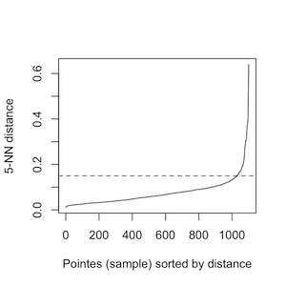
Determining Eps and MinPts
Idea is that for points in a cluster, their kth nearest neighbors are at roughly the same distance
Noise points have the kth nearest neighbor at farther distance
So, plot sorted distance of every point to its kth nearest neighbor

Slide 20
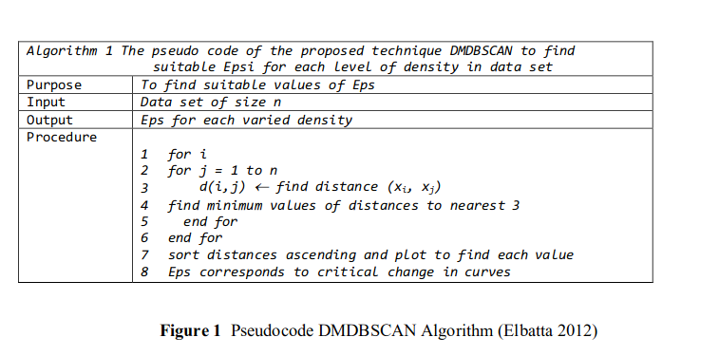
Determining Eps and MinPts

Slide 21
When DBSCAN works well

Slide 22
When DBSCAN Does NOT Work Well

Slide 23
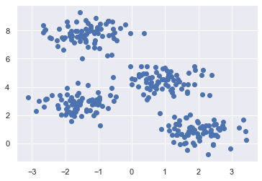
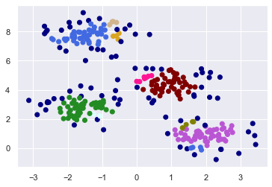
Code snippets
import numpy as np
from sklearn.datasets.samples_generator import make_blobs
from sklearn.neighbors import NearestNeighbors
from sklearn.cluster import DBSCAN
from matplotlib import pyplot as plt
import seaborn as sns
sns.set()
X, y = make_blobs(n_samples=300, centers=4, cluster_std=0.60, random_state=0)
plt.scatter(X[:,0], X[:,1])
m = DBSCAN(eps=0.3, min_samples=5)
m.fit(X)
clusters = m.labels_
colors = ['royalblue', 'maroon', 'forestgreen', 'mediumorchid', 'tan', 'deeppink', 'olive', 'goldenrod', 'lightcyan', 'navy']
vectorizer = np.vectorize(lambda x: colors[x % len(colors)])
plt.scatter(X[:,0], X[:,1], c=vectorizer(clusters))

Slide 24
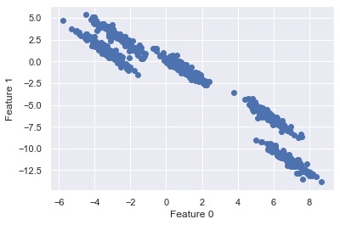
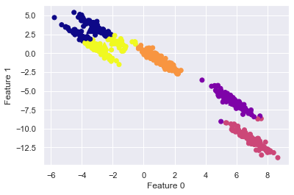
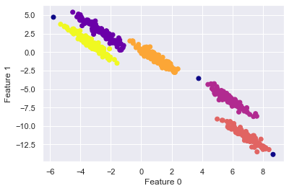
DBSCAN Vs K-Means
K-Means
DBSCAN

Slide 25
Thank You!!

